Slide 1
Mapping areas of operation of Mexican criminal groups
By Michele Coscia* and Viridiana Rios**
Results: Zetas, Familia, Golfo, Sinaloa, Juarez, Tijuana, Barbie, and Beltran Leyva,
Methodology: Automatized search algorithm designed to extract online content from specialized blogs and local newspapers filtering assuming an hypergeometric distribution. The algorithm uses as inputs key terms that proxy for location and membership to criminal organizations, and provides as outputs the municipalities in which 16 criminal organizations have operated from 1999 to 2010.
Source: Coscia, Michele and Viridiana Rios “Knowing Where and How Criminal Organizations Operate Using Web Content” in CIKM’12, October 29–November 2, 2012, Maui, HI, USA. Copyright 2012 ACM 978-1-4503-1156-4/12/10
*Fellow at Google and at the Center for International Development, Harvard Kennedy School (HKS).
*Department of Government, Harvard University; Fellow in Inequality & Criminal Justice, HKS.

Slide 2
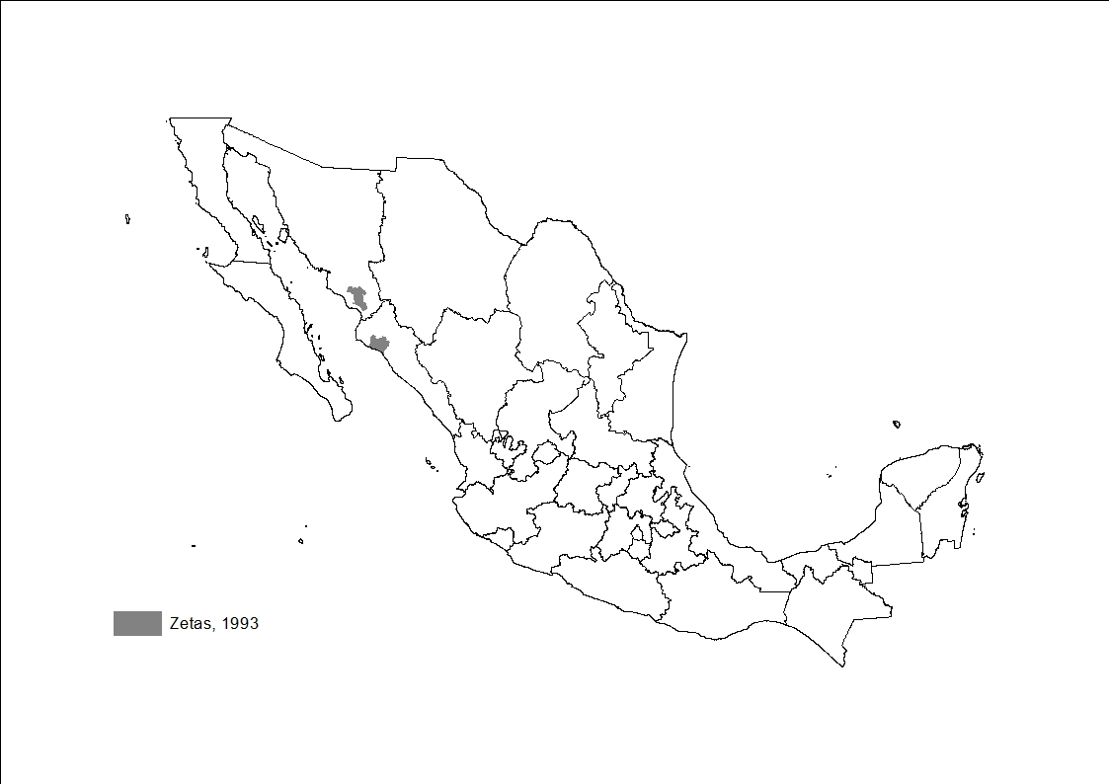
Back to main menu

Slide 3

Back to main menu

Slide 4
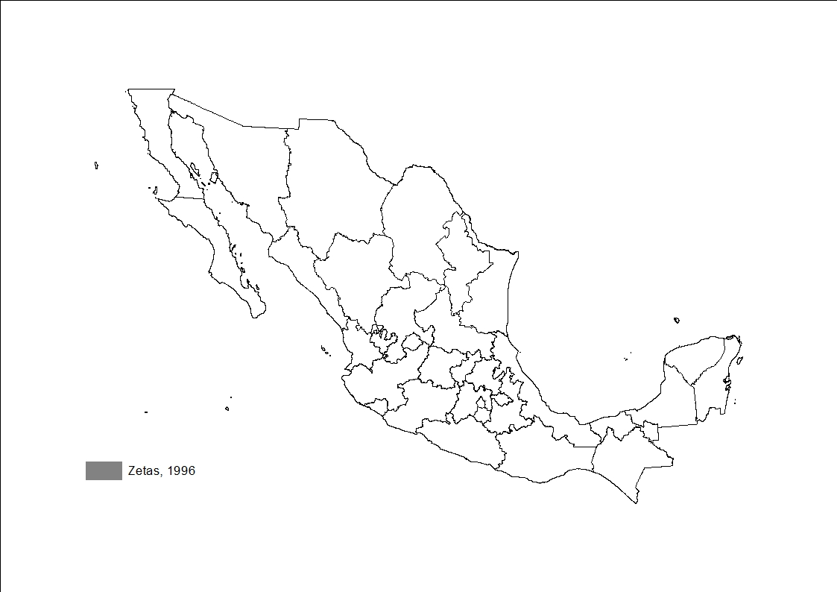
Back to main menu

Slide 5
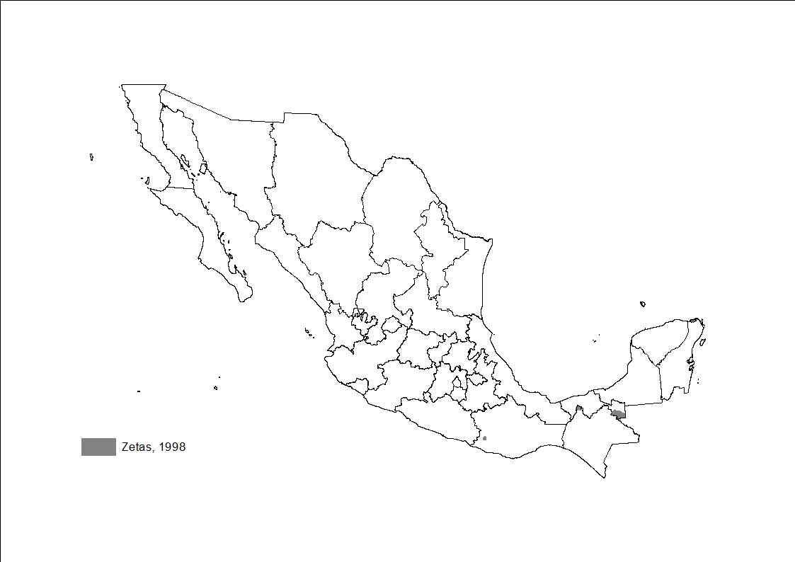
Back to main menu

Slide 6

Back to main menu

Slide 7

Back to main menu

Slide 8

Back to main menu

Slide 9

Back to main menu

Slide 10
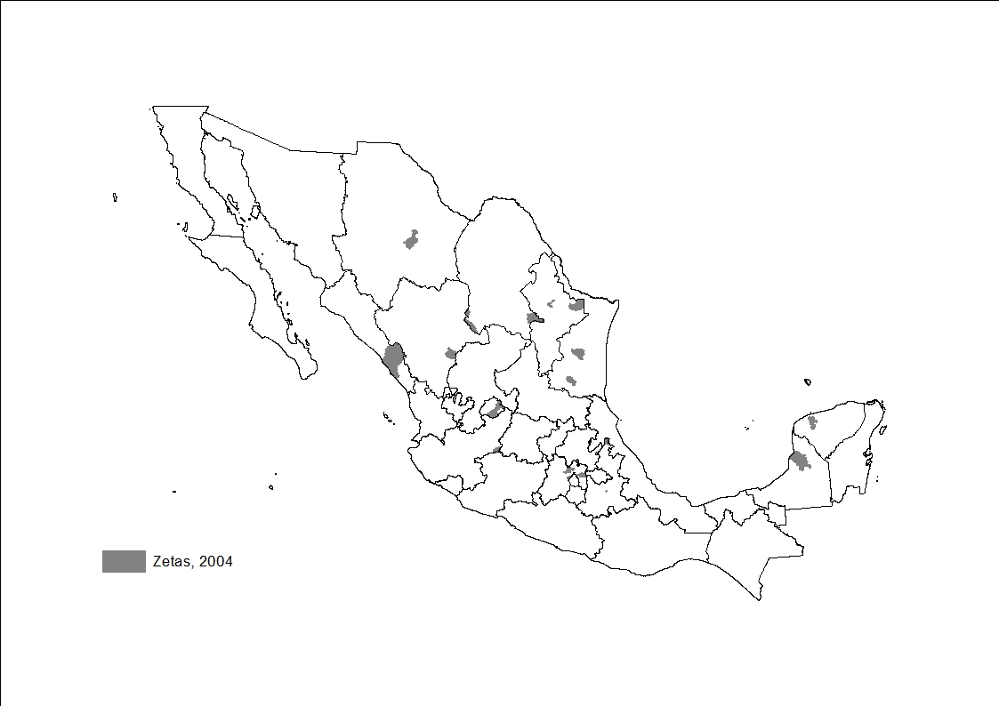
Back to main menu

Slide 11
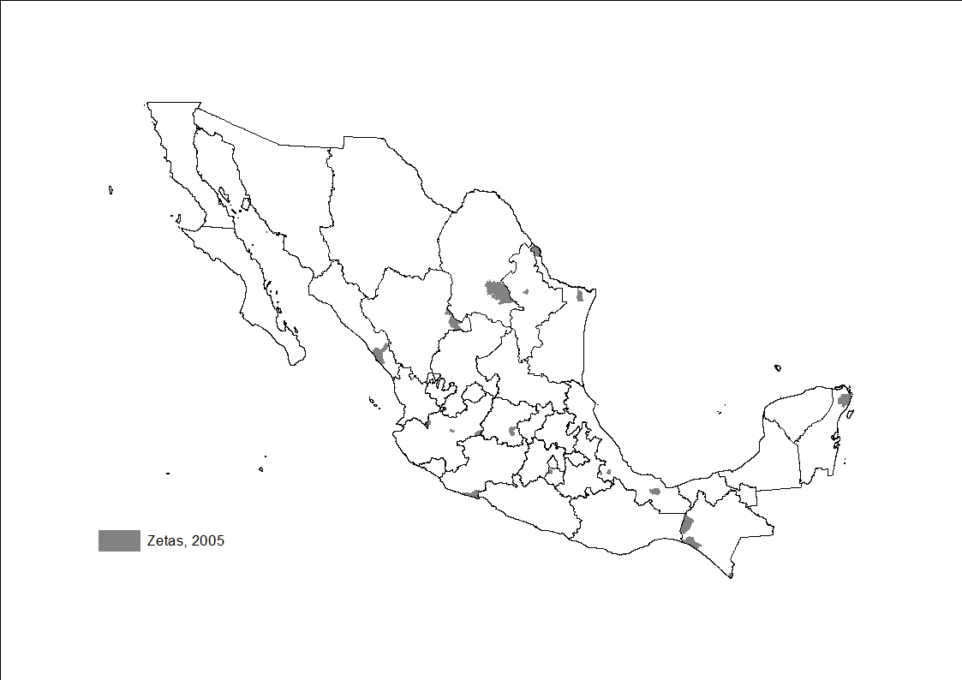
Back to main menu

Slide 12
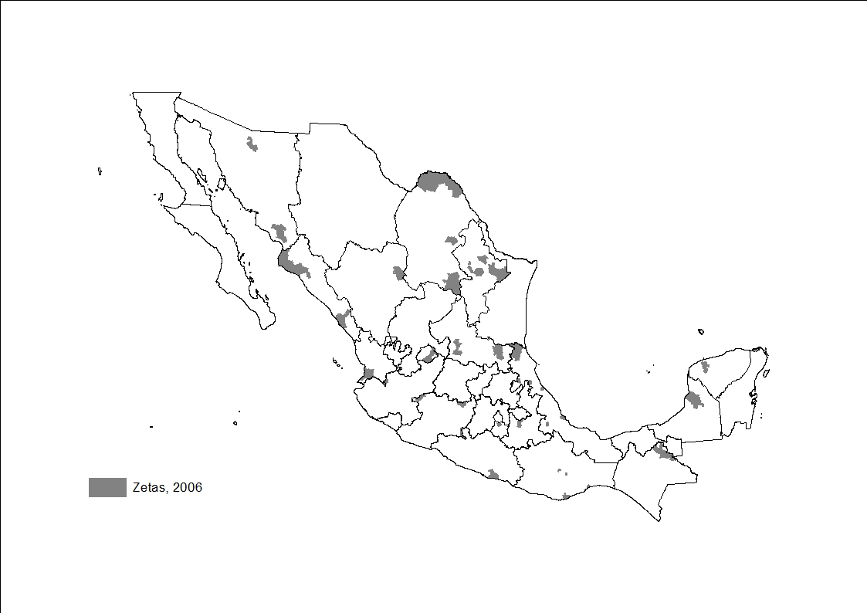
Back to main menu

Slide 13
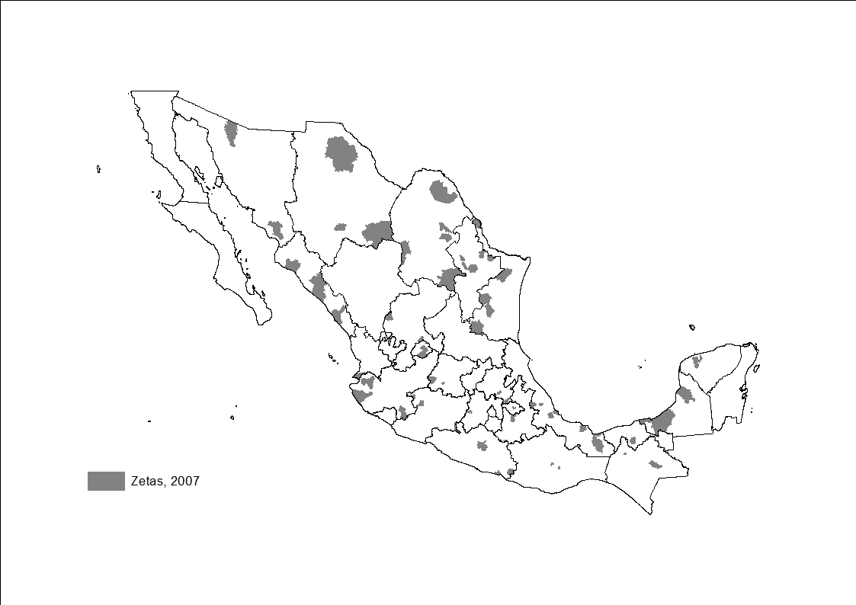
Back to main menu

Slide 14
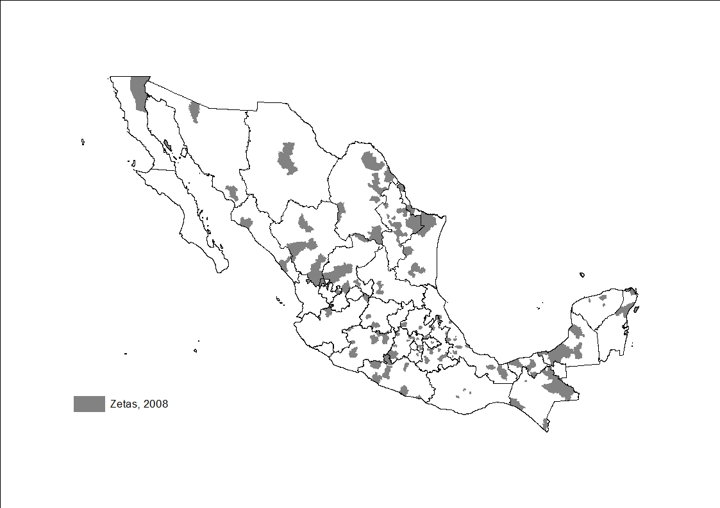
Back to main menu

Slide 15
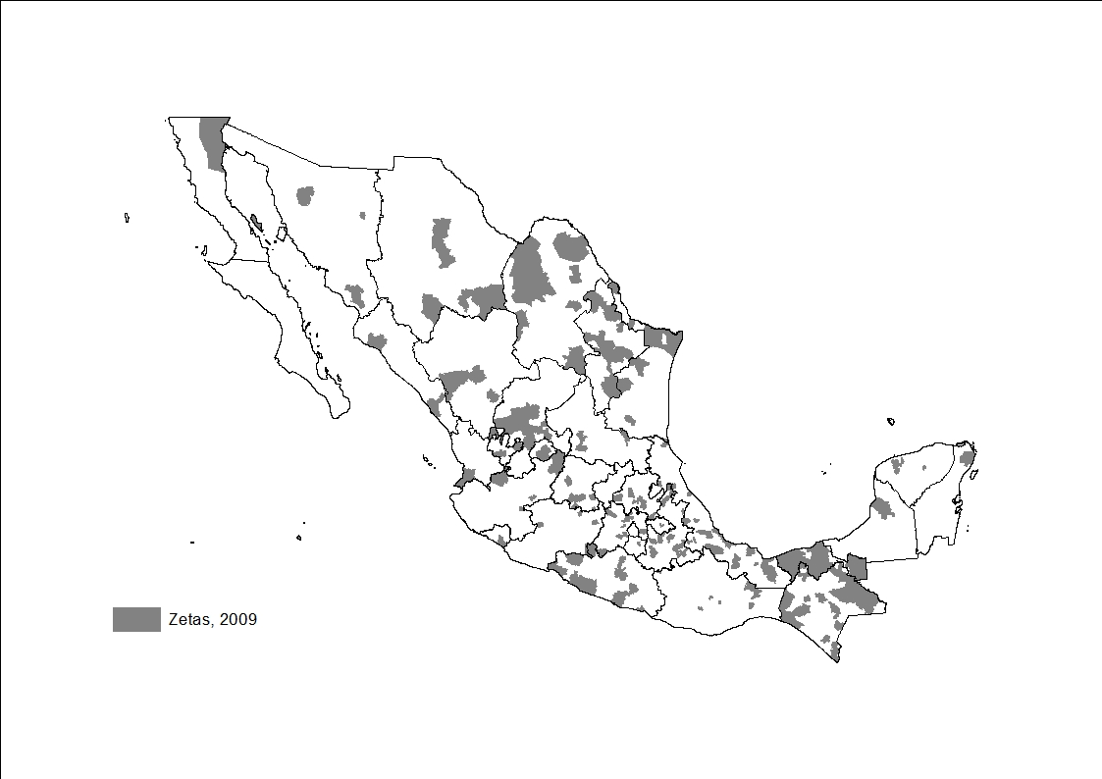
Back to main menu

Slide 16
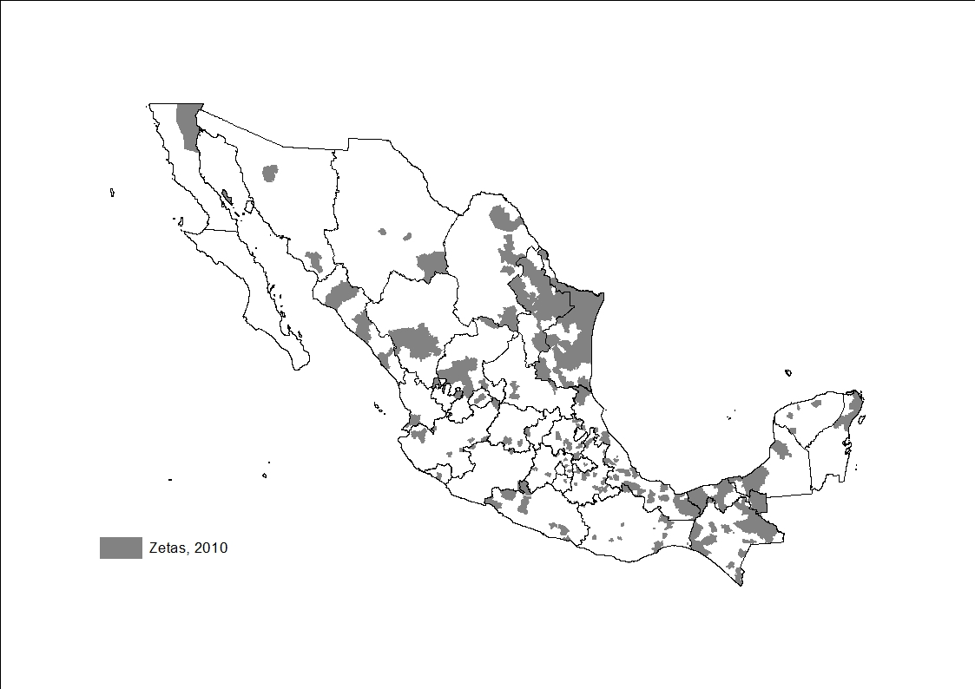
Back to main menu

Slide 17
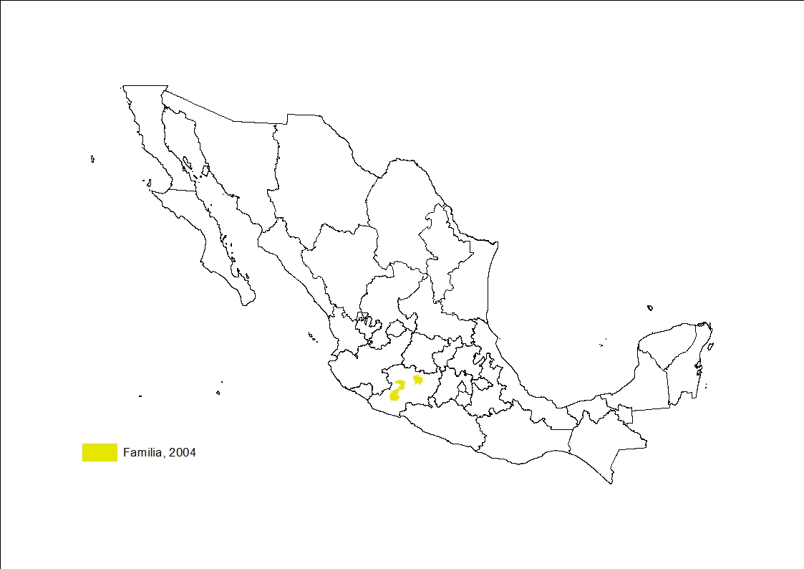
Back to main menu

Slide 18
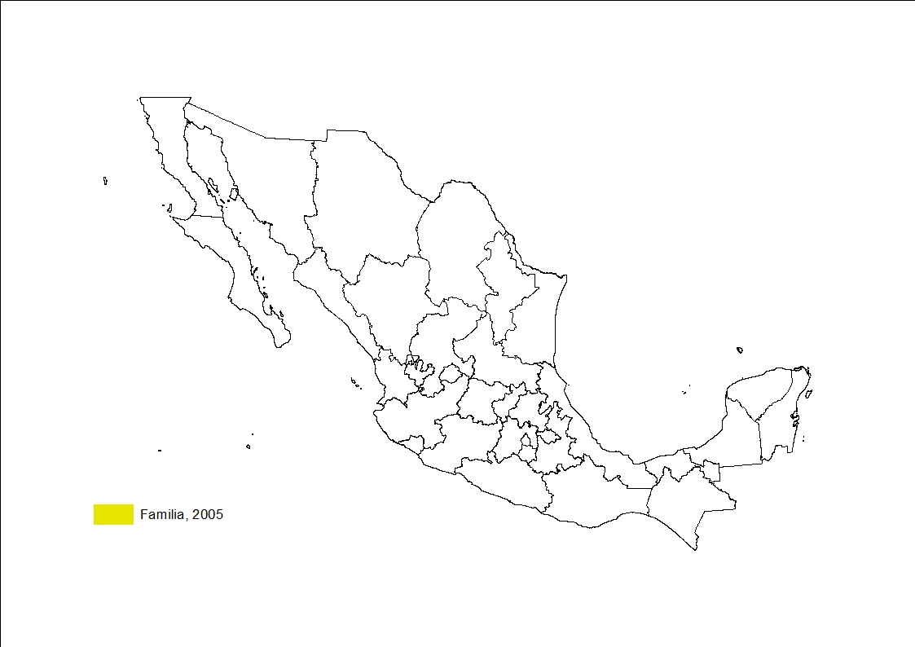
Back to main menu

Slide 19
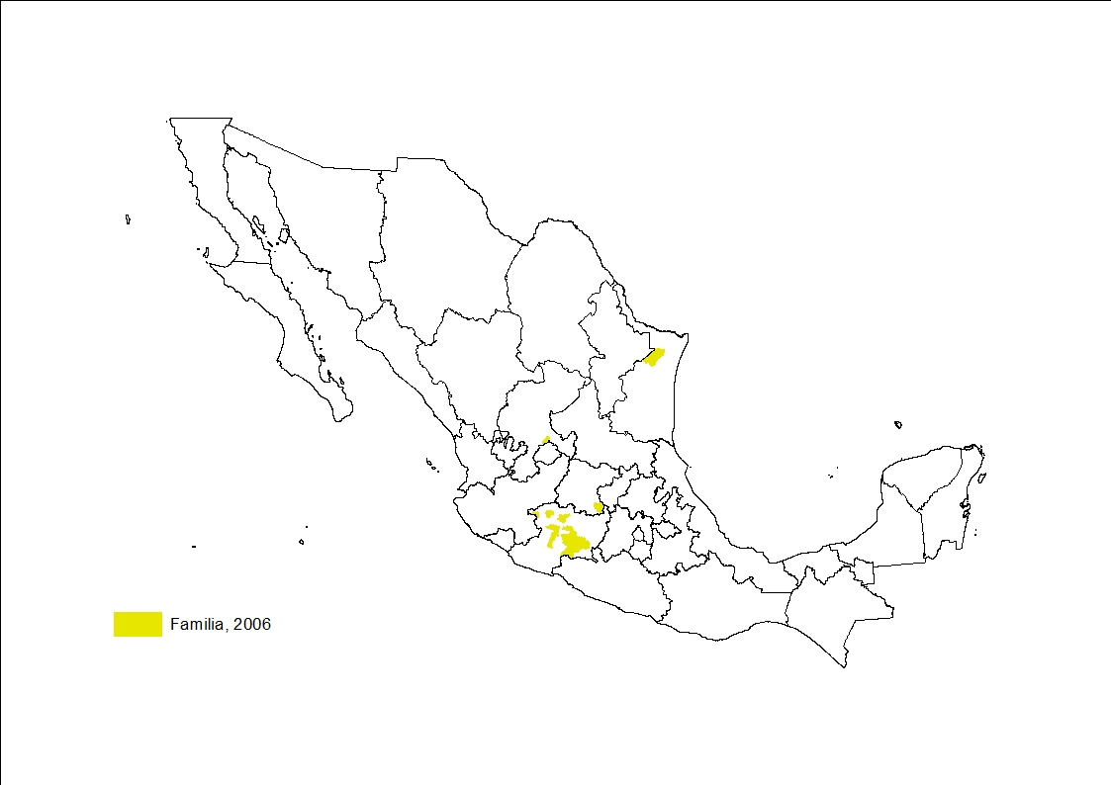
Back to main menu

Slide 20

Back to main menu

Slide 21
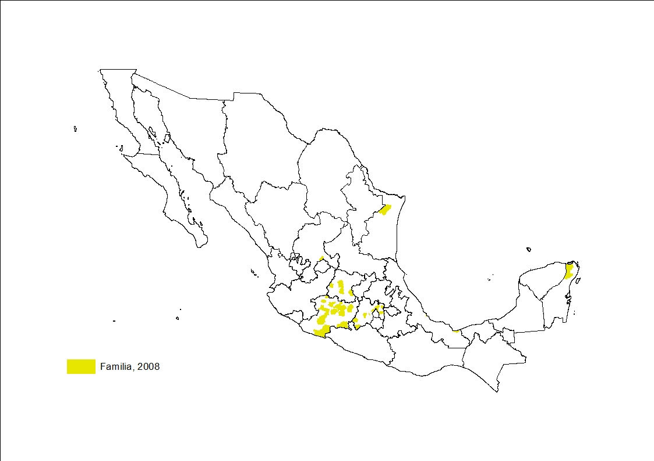
Back to main menu

Slide 22
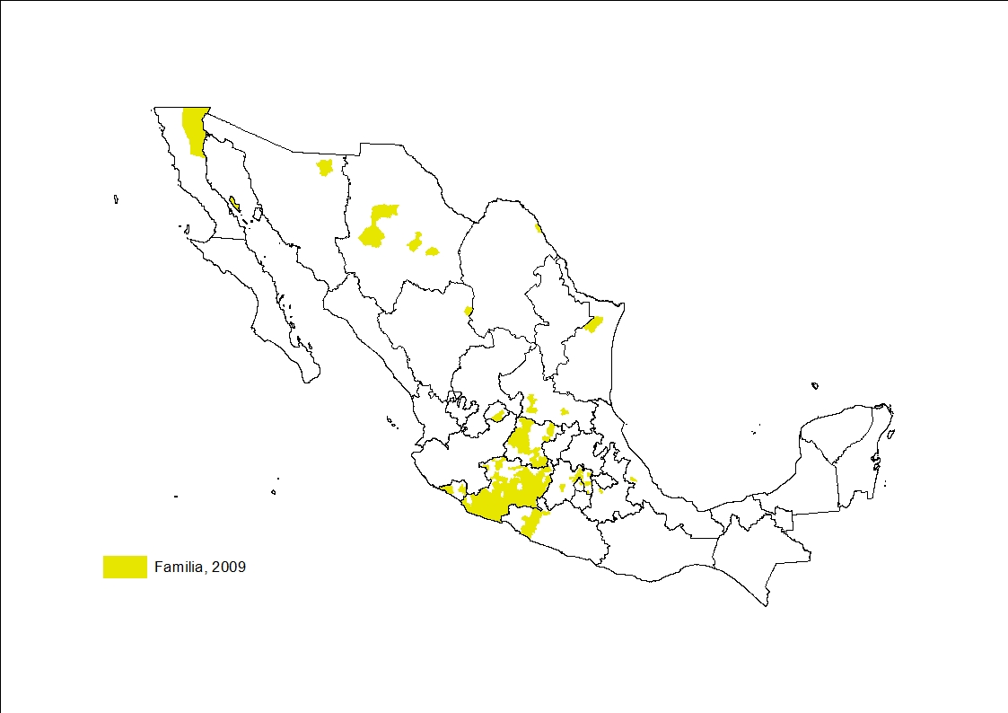
Back to main menu

Slide 23
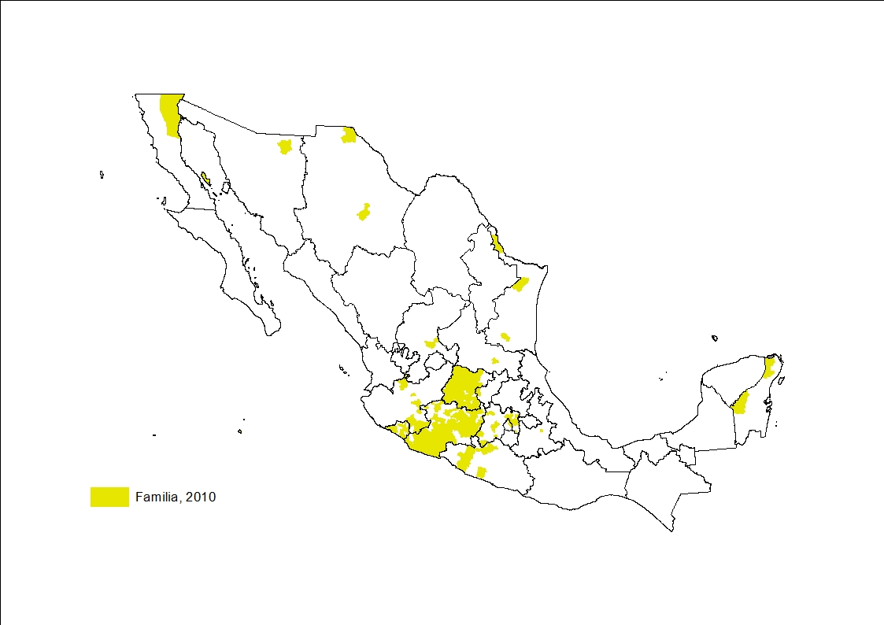
Back to main menu

Slide 24
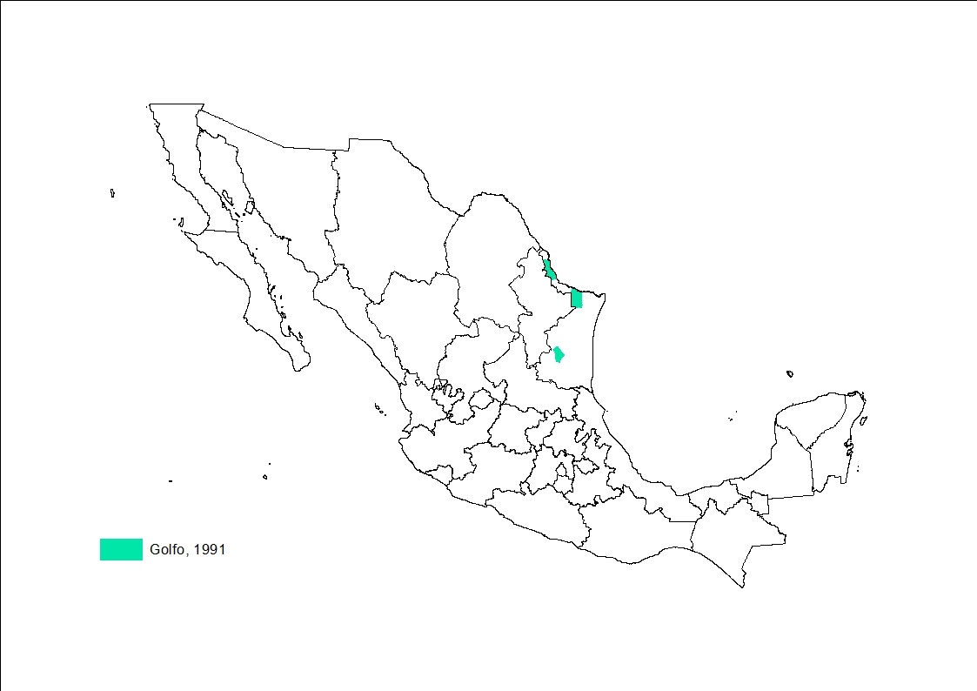
Back to main menu

Slide 25
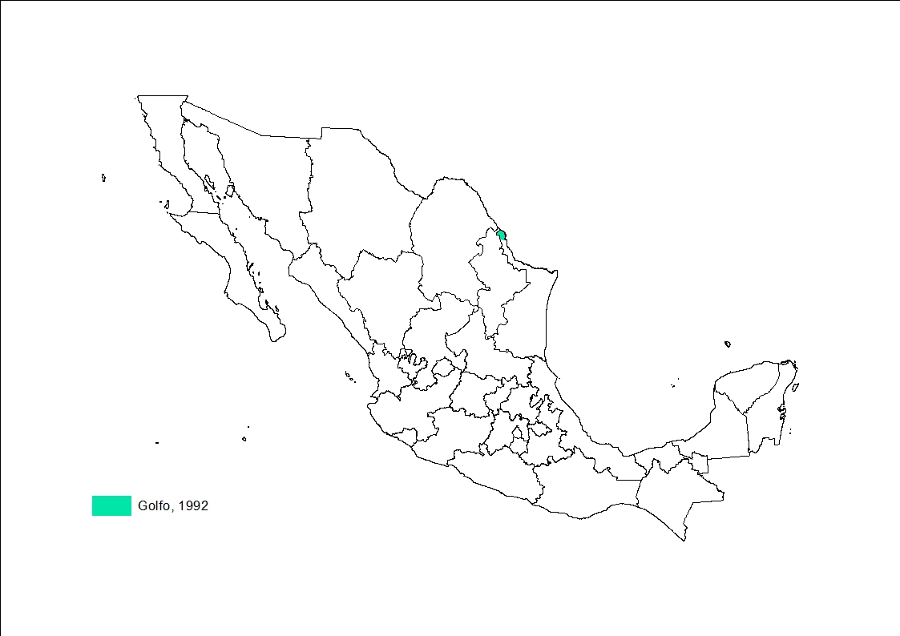
Back to main menu

Slide 26

Back to main menu

Slide 27
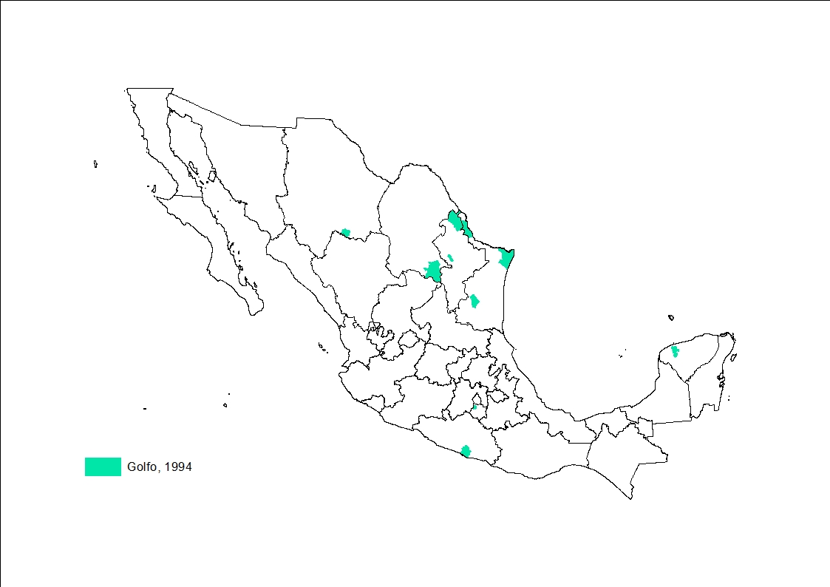
Back to main menu

Slide 28
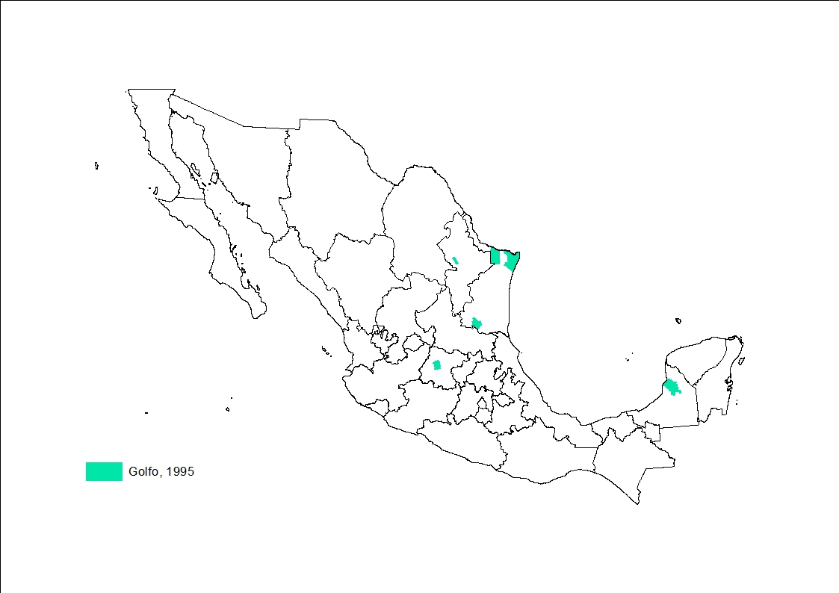
Back to main menu

Slide 29
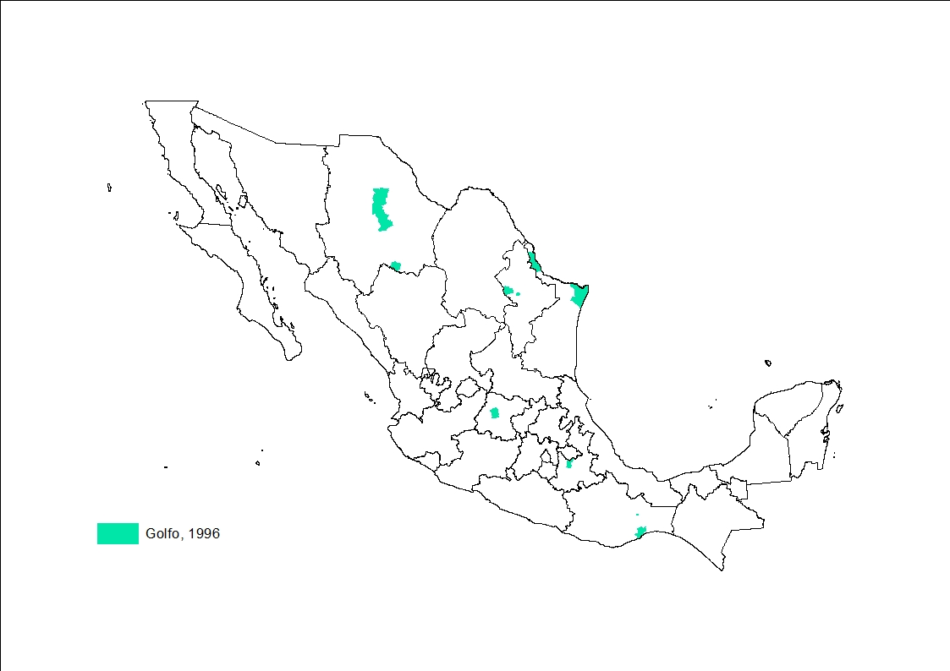
Back to main menu

Slide 30

Back to main menu

Slide 31
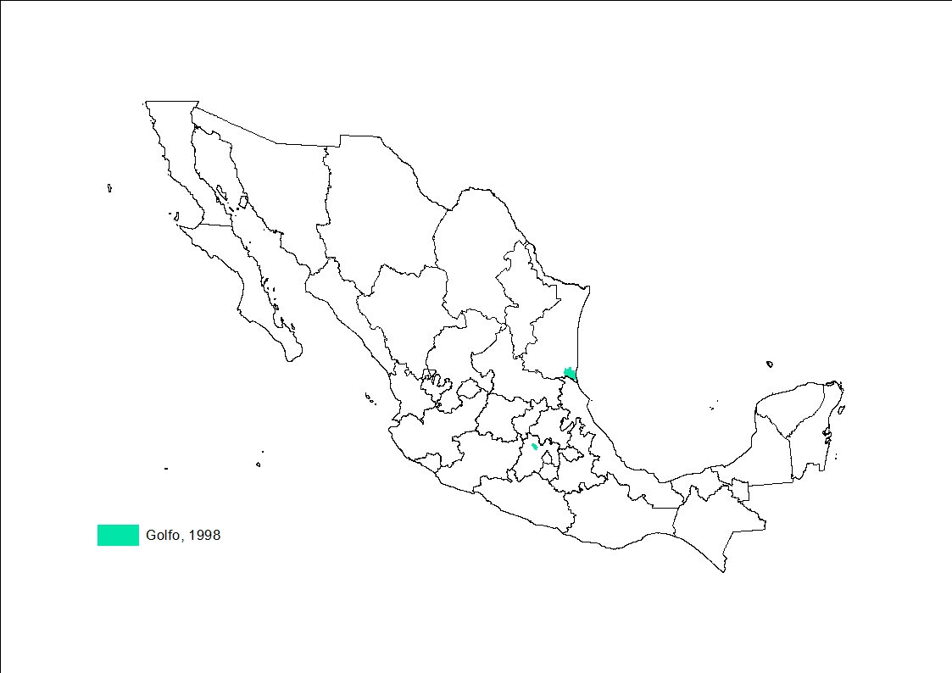
Back to main menu

Slide 32

Back to main menu

Slide 33

Back to main menu

Slide 34

Back to main menu

Slide 35
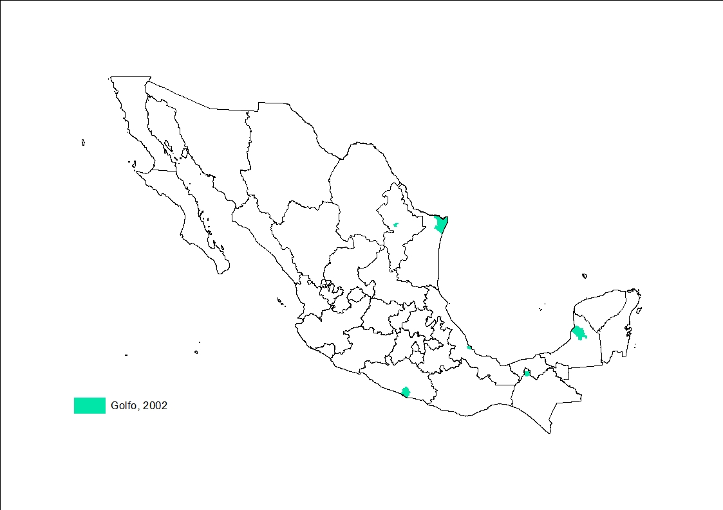
Back to main menu

Slide 36
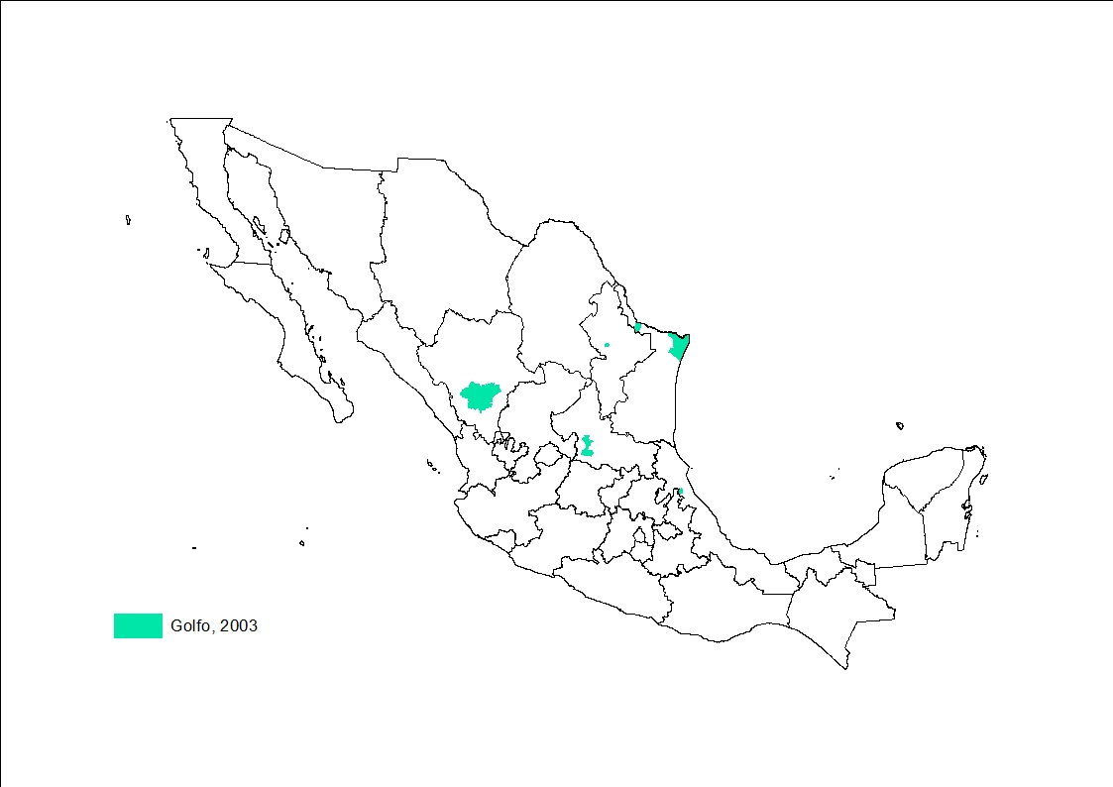
Back to main menu

Slide 37
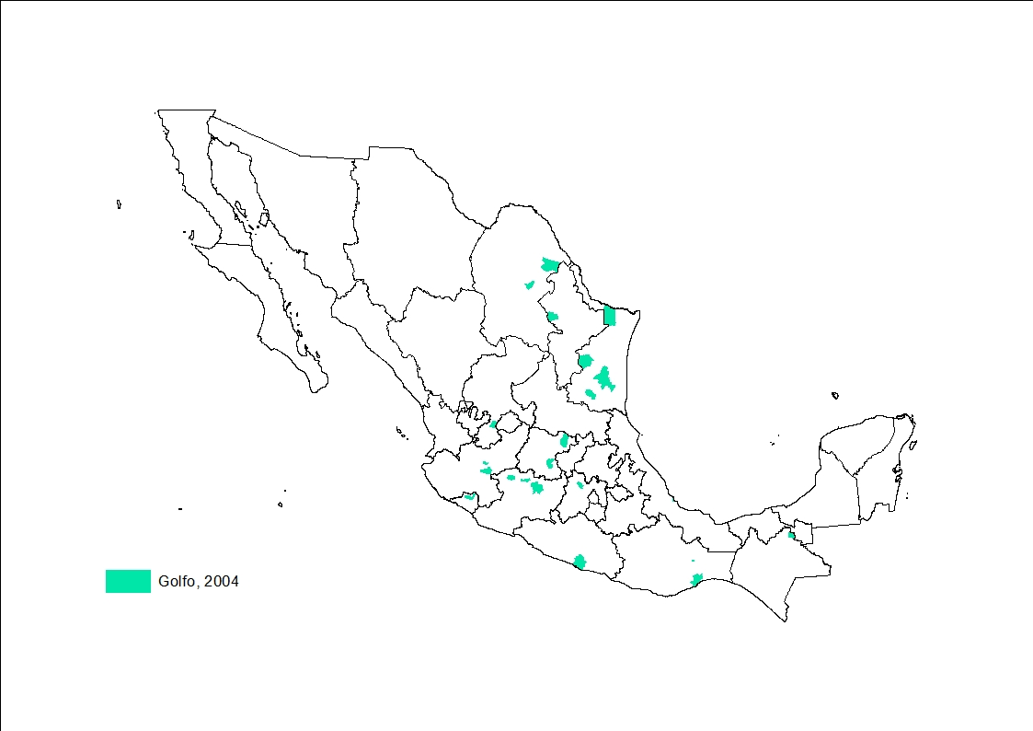
Back to main menu

Slide 38
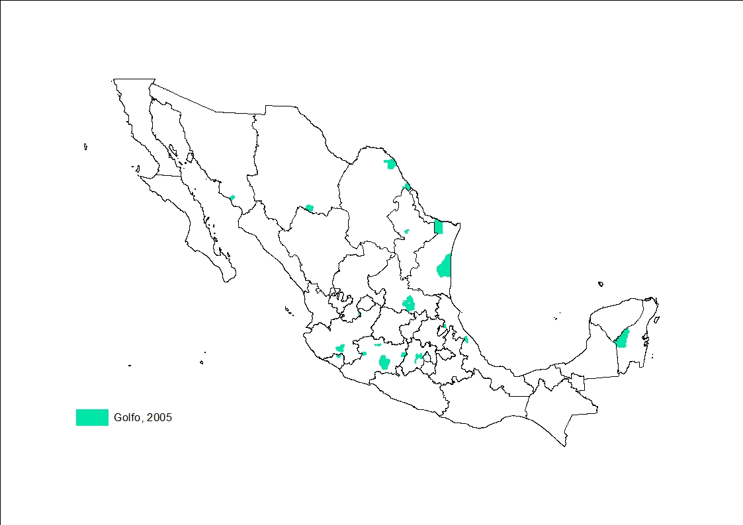
Back to main menu

Slide 39
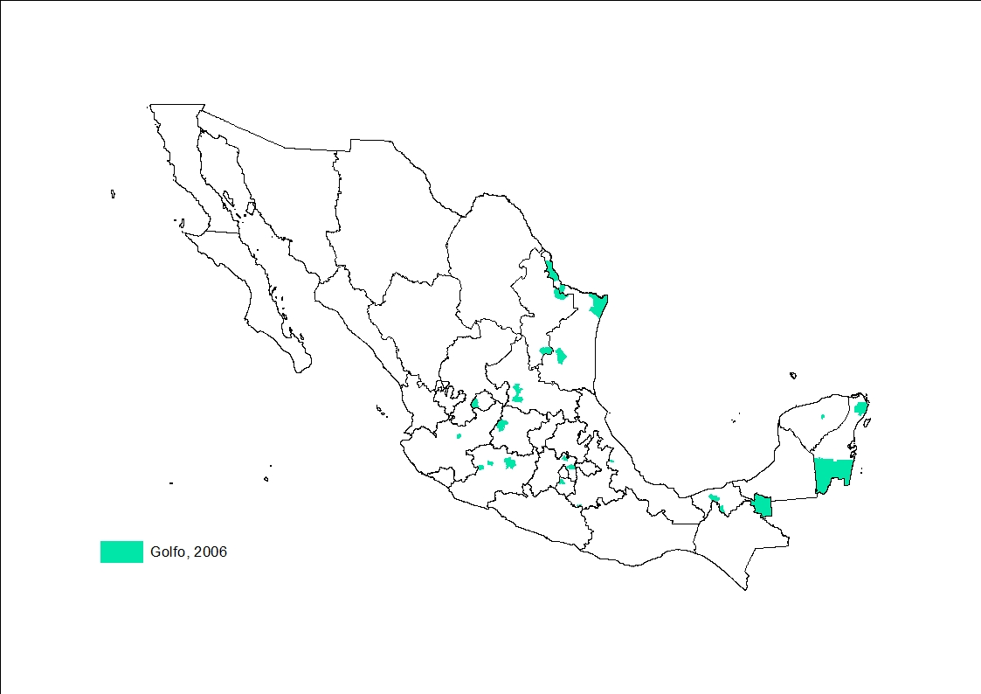
Back to main menu

Slide 40
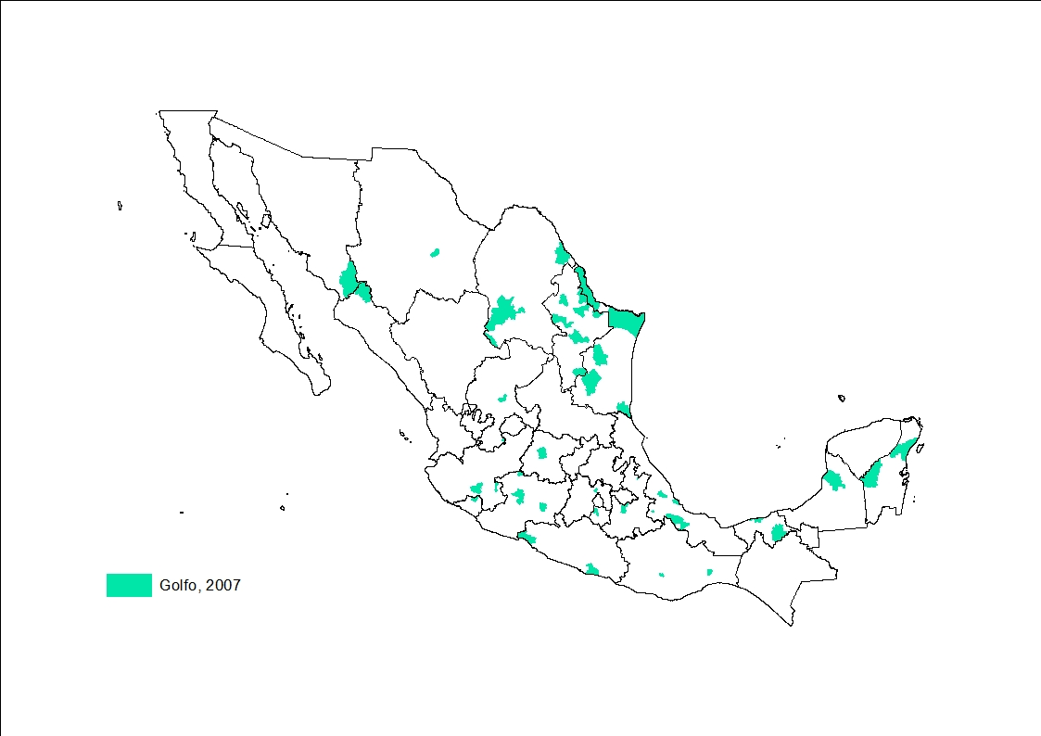
Back to main menu

Slide 41
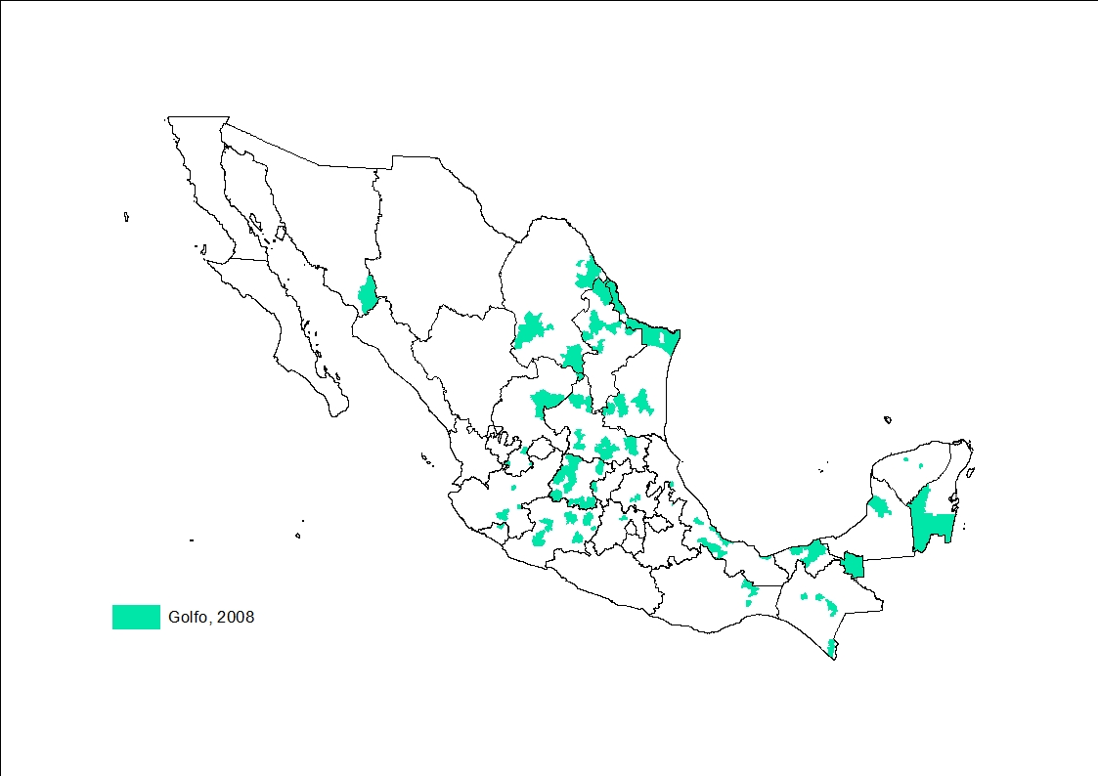
Back to main menu

Slide 42
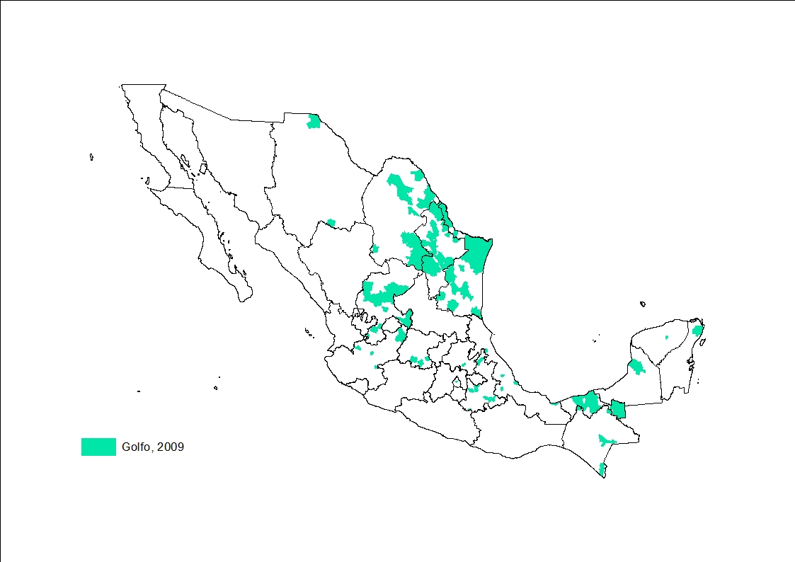
Back to main menu

Slide 43
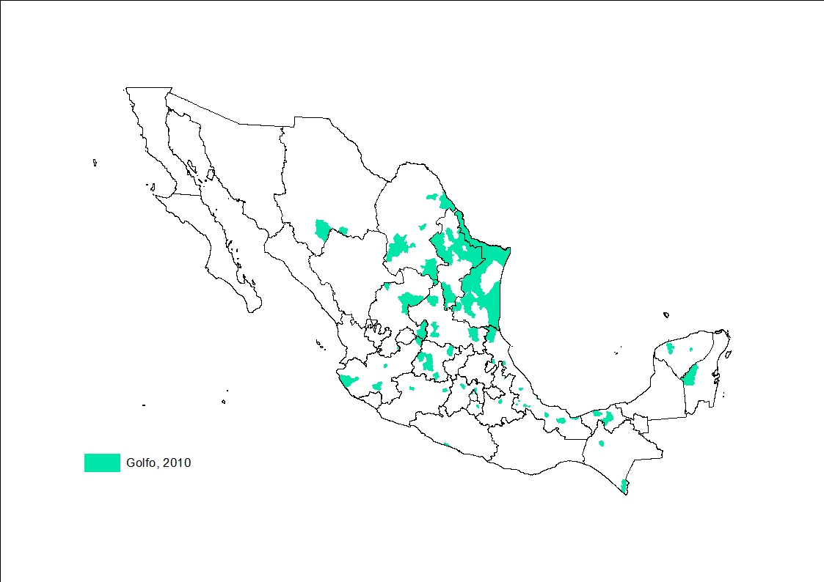
Back to main menu

Slide 44
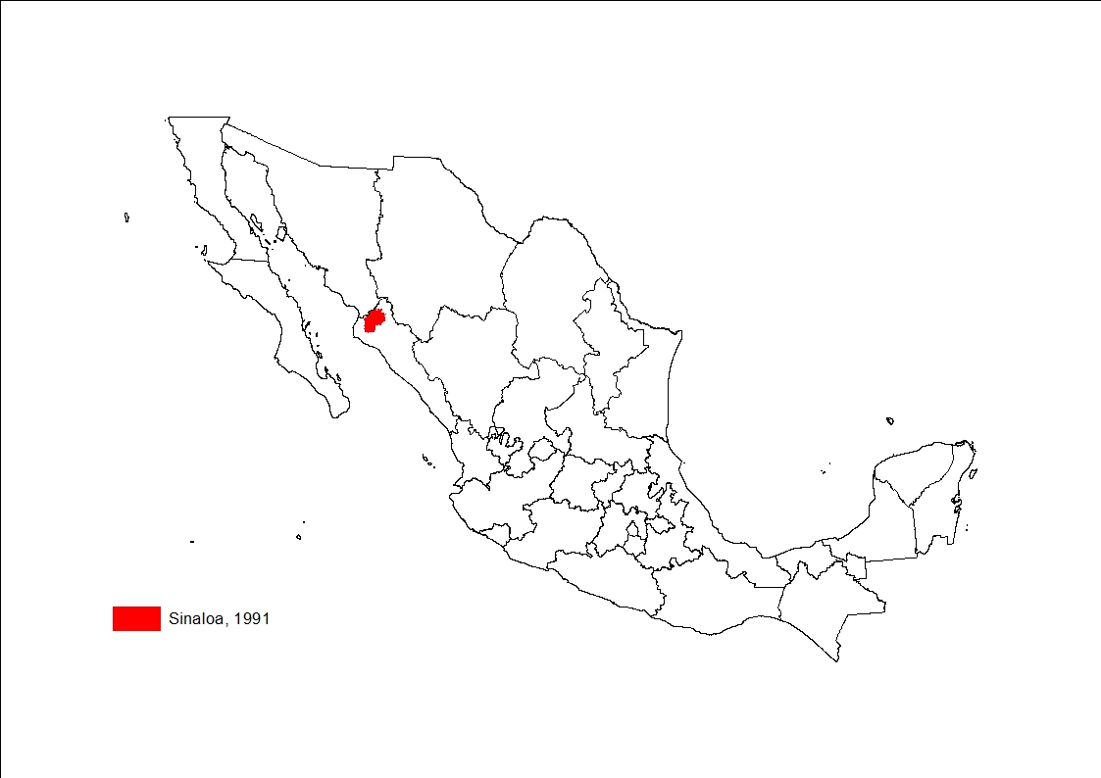
Back to main menu

Slide 45
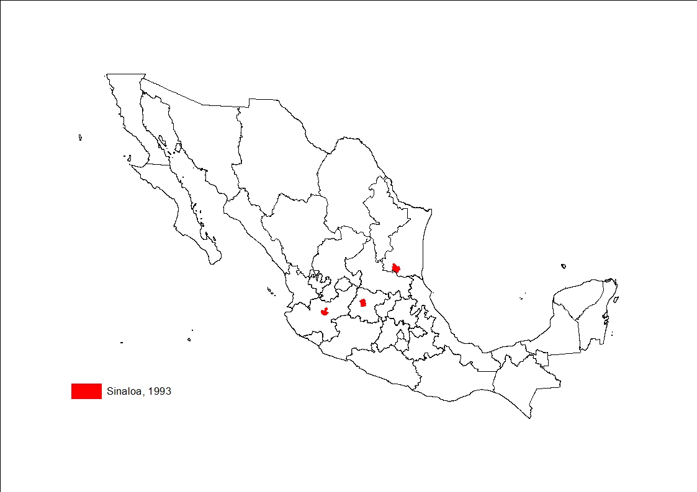
Back to main menu

Slide 46
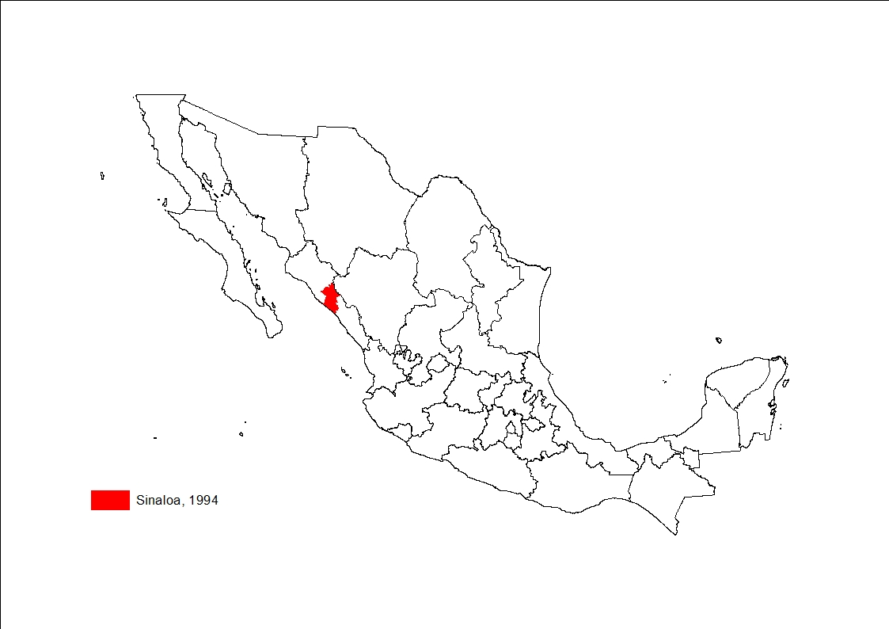
Back to main menu

Slide 47
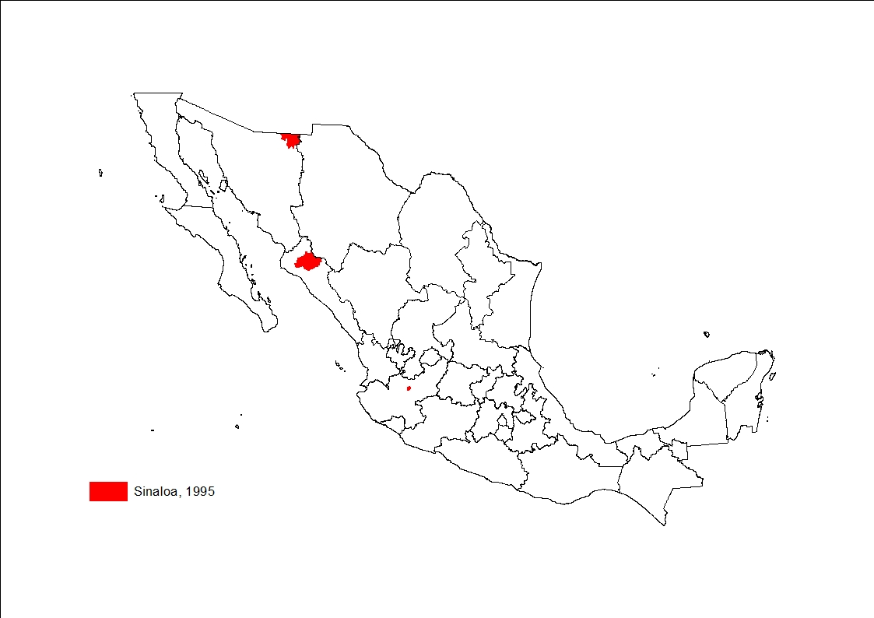
Back to main menu

Slide 48
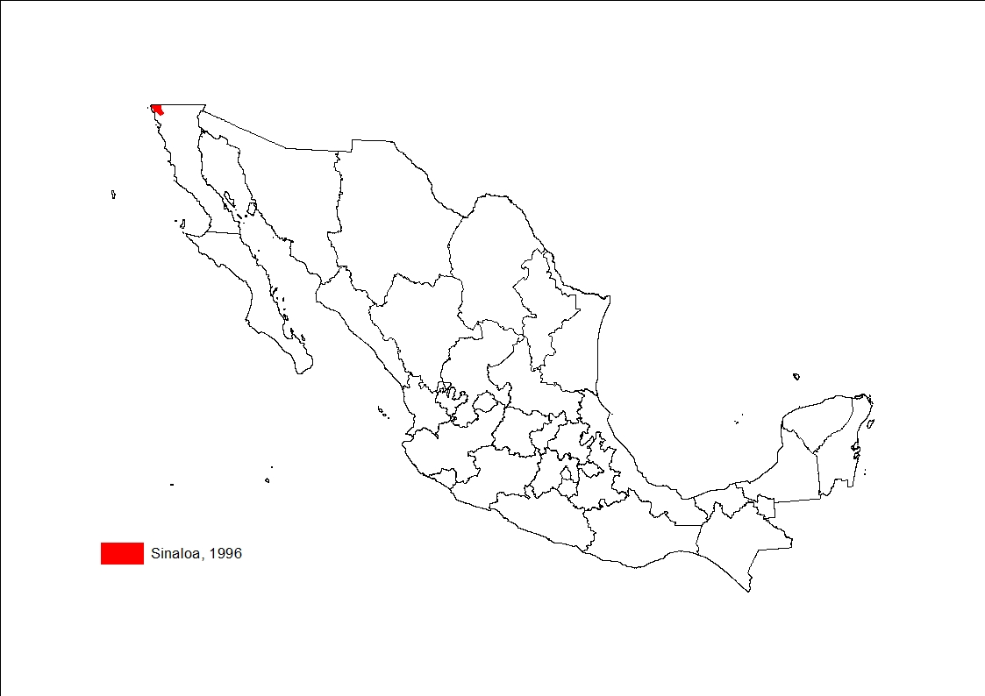
Back to main menu

Slide 49
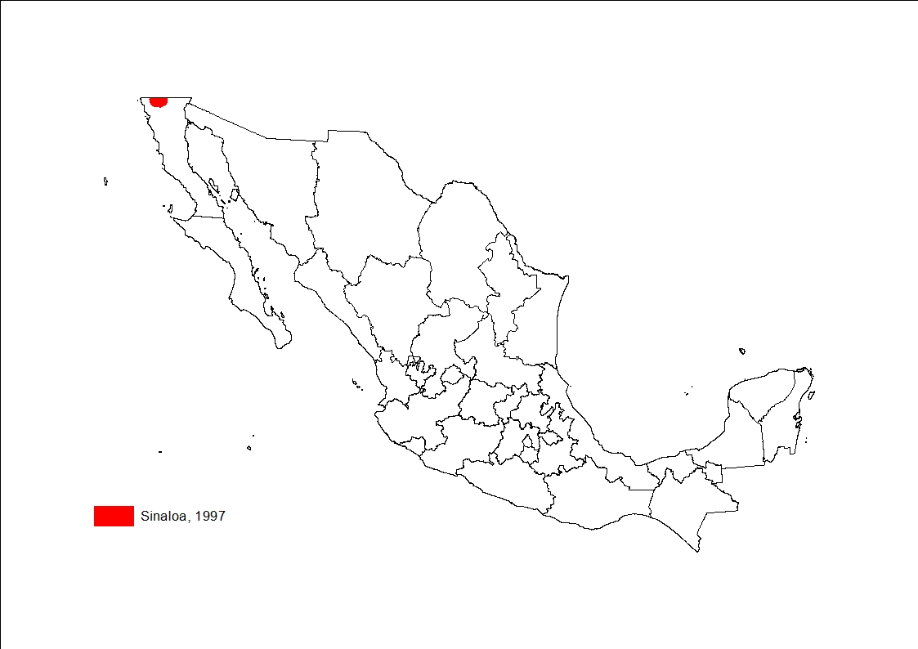
Back to main menu

Slide 50
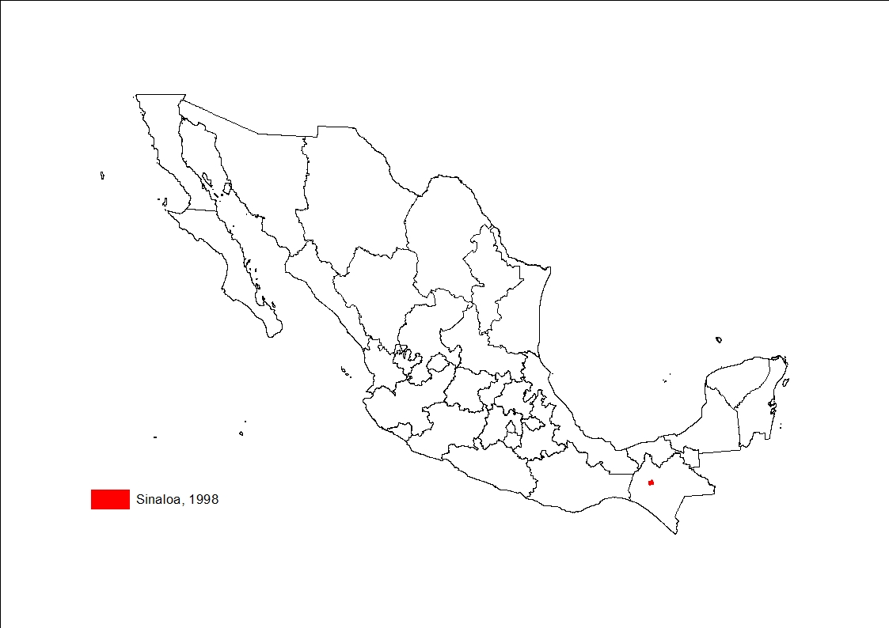
Back to main menu

Slide 51

Back to main menu

Slide 52
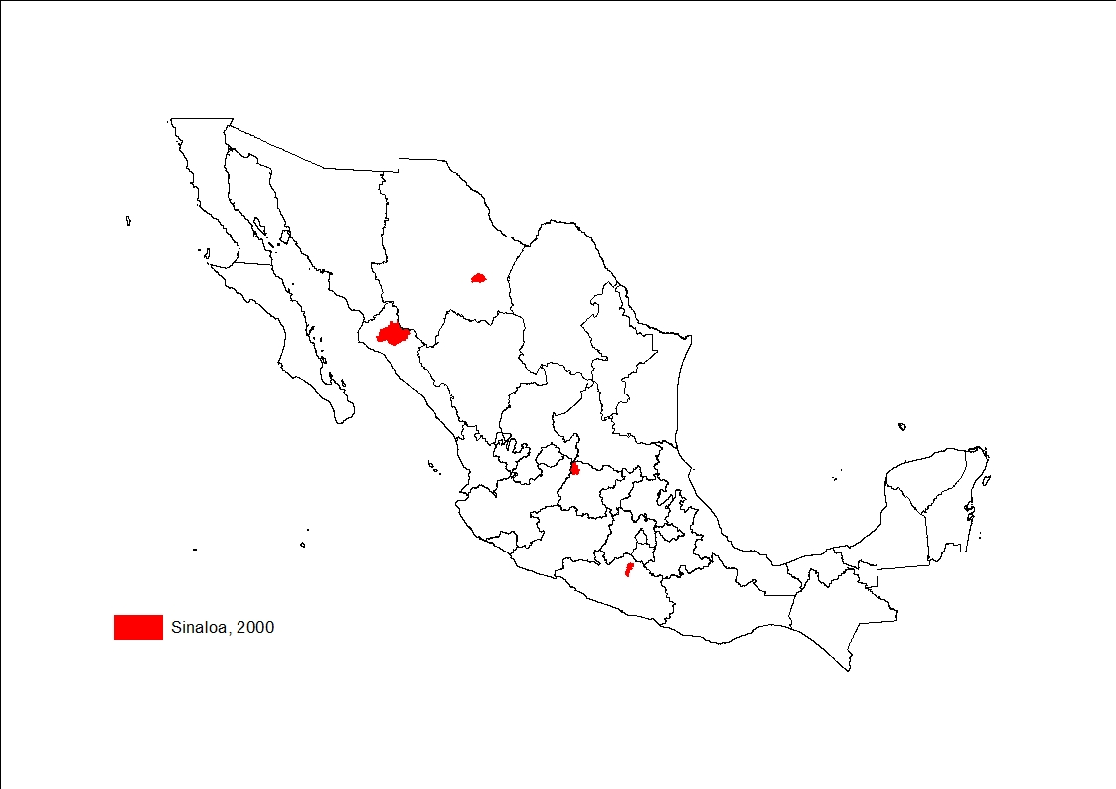
Back to main menu

Slide 53
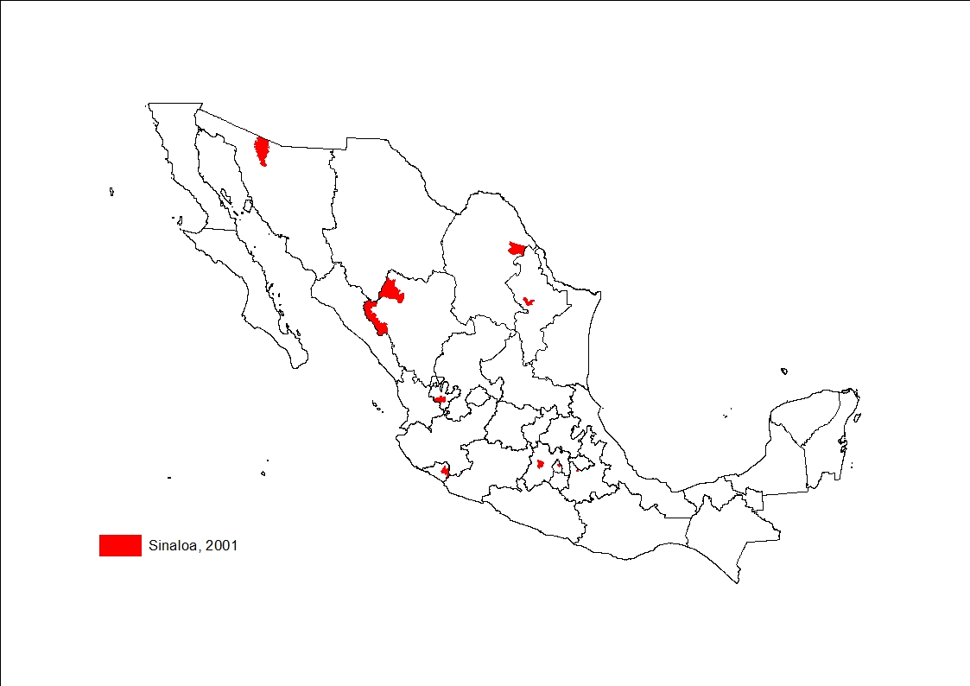
Back to main menu

Slide 54

Back to main menu

Slide 55
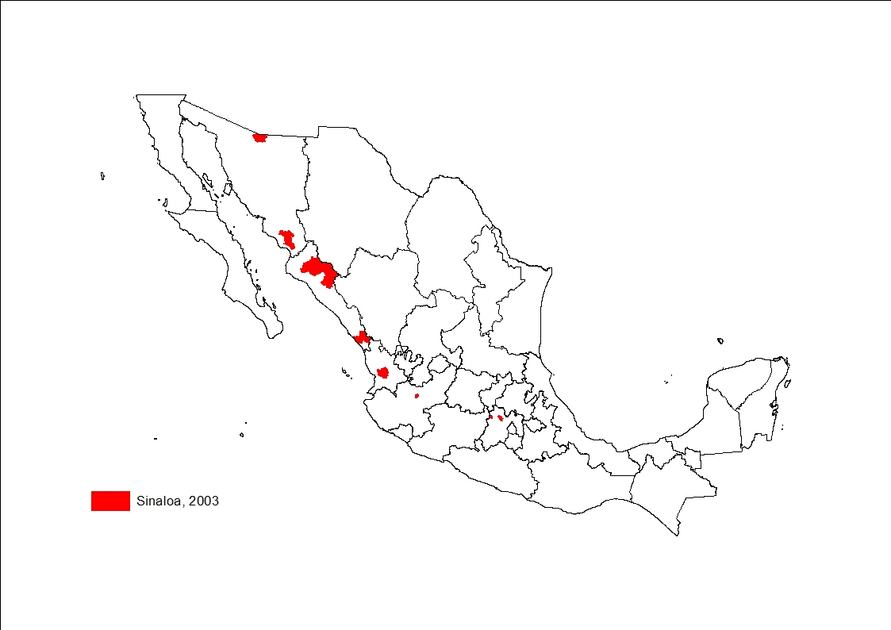
Back to main menu

Slide 56
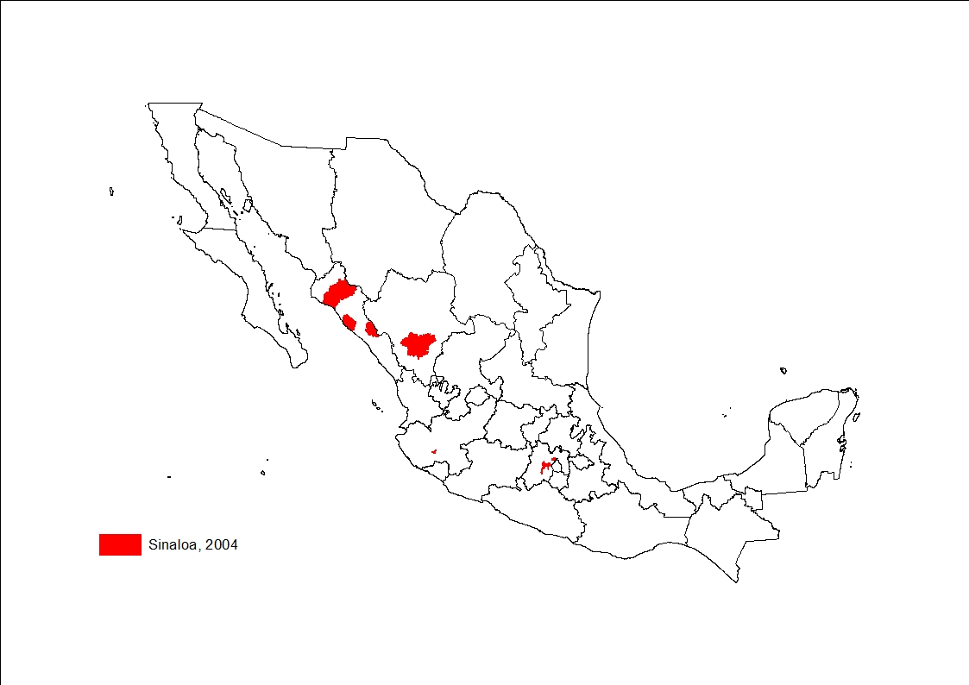
Back to main menu

Slide 57
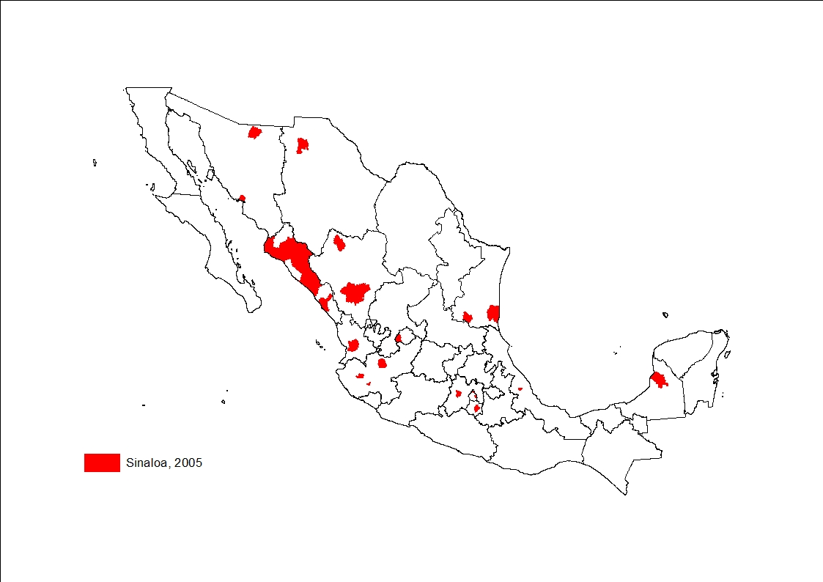
Back to main menu

Slide 58
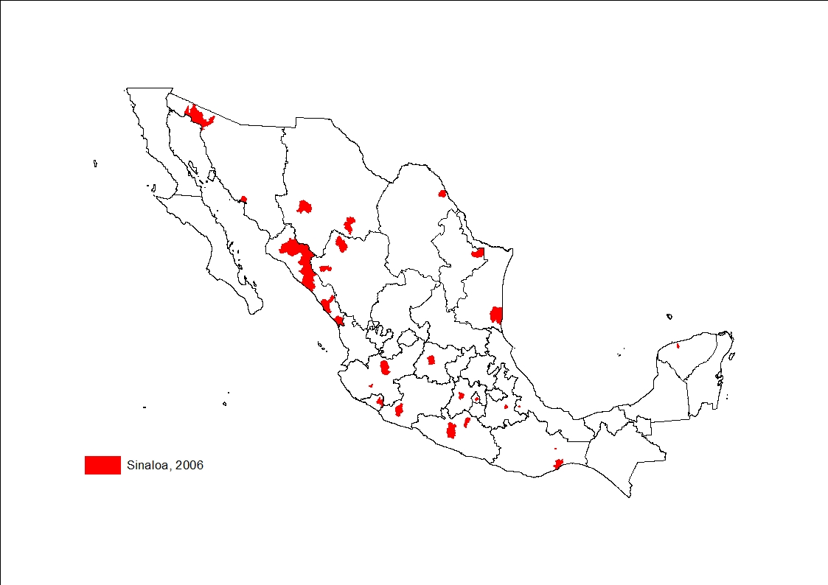
Back to main menu

Slide 59
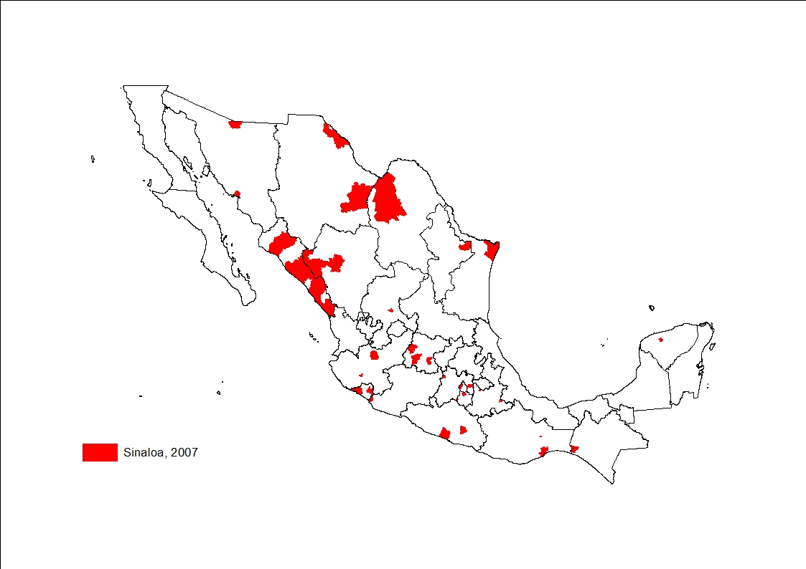
Back to main menu

Slide 60
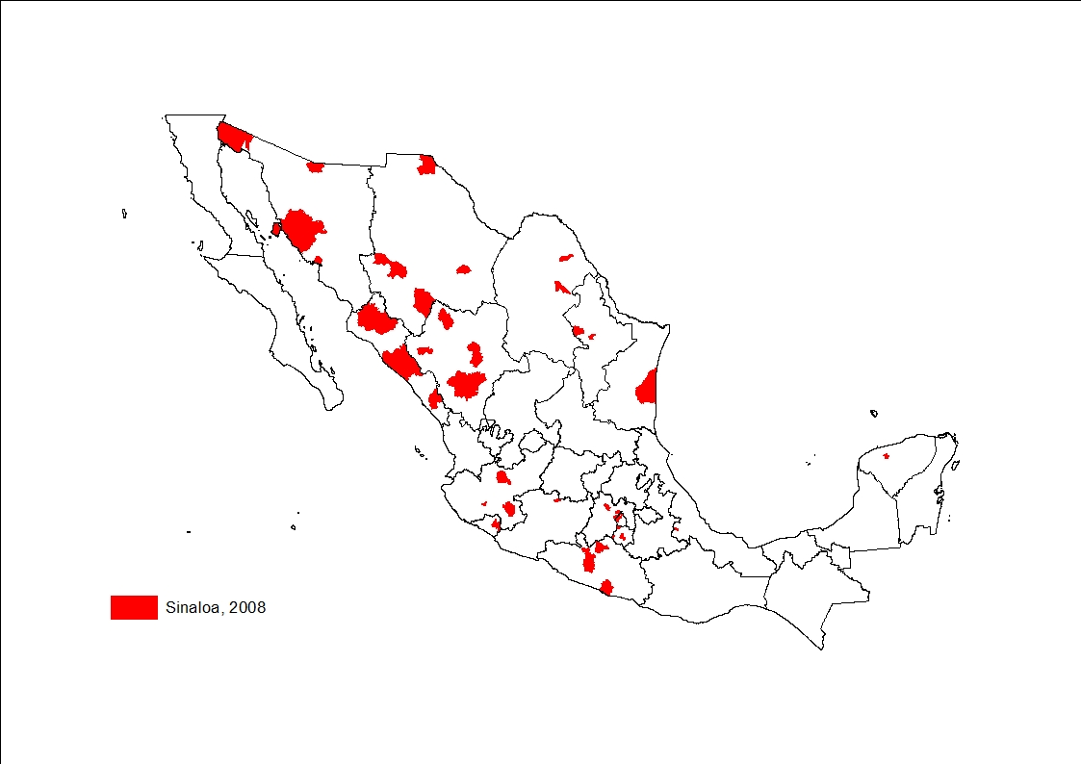
Back to main menu

Slide 61
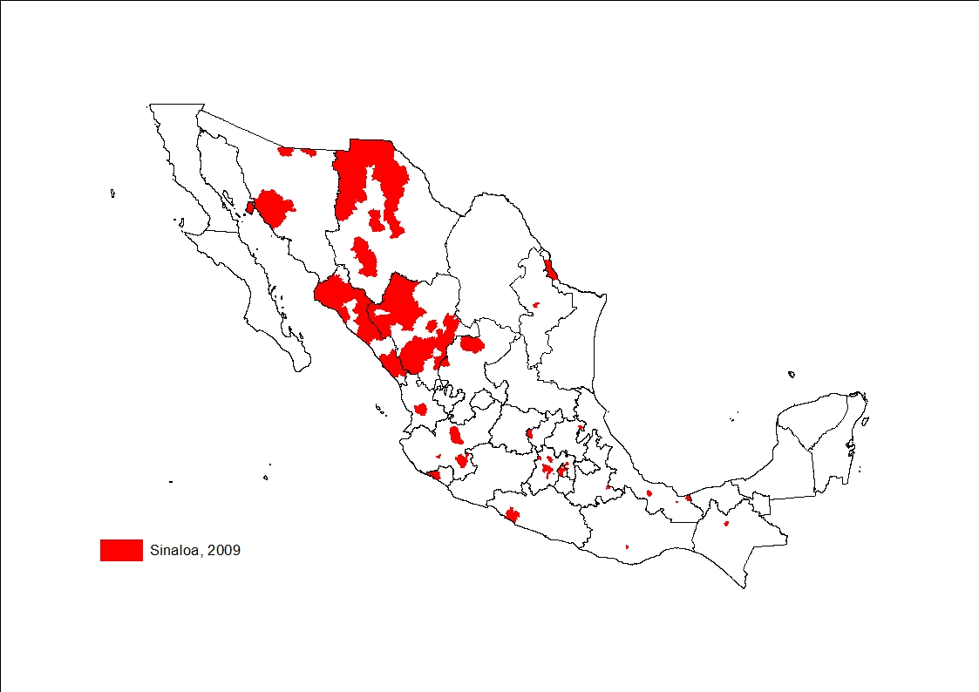
Back to main menu

Slide 62
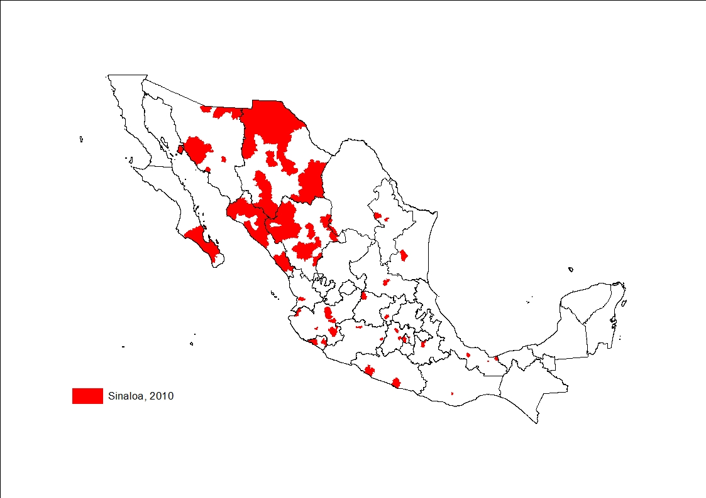
Back to main menu

Slide 63
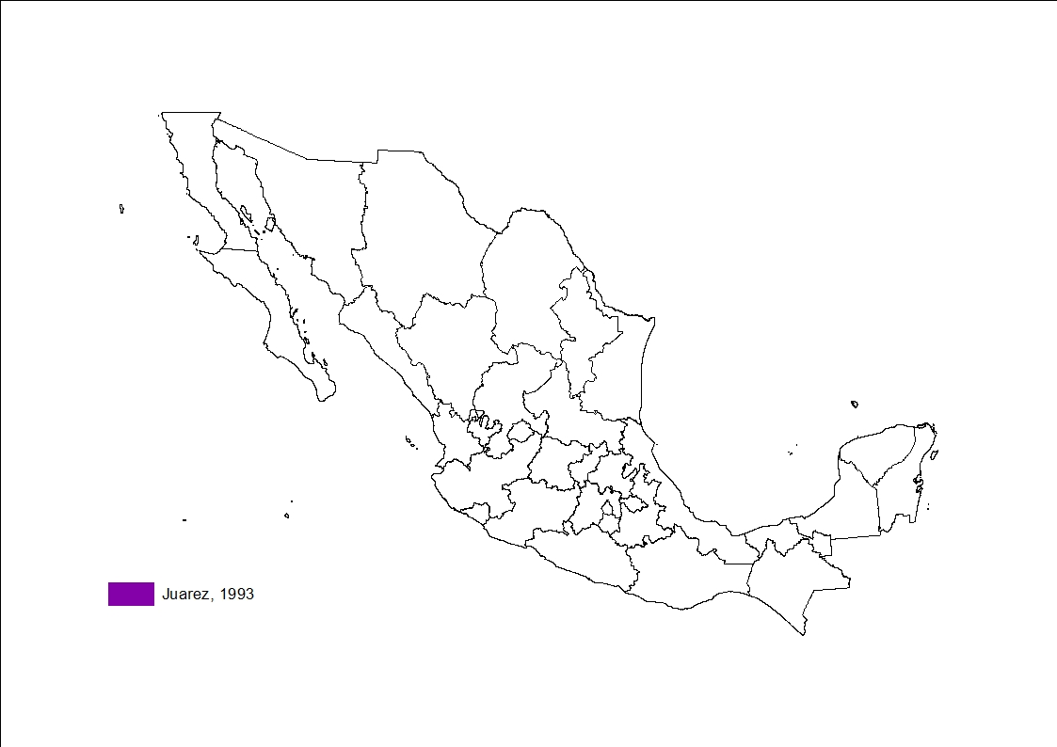
Back to main menu

Slide 64
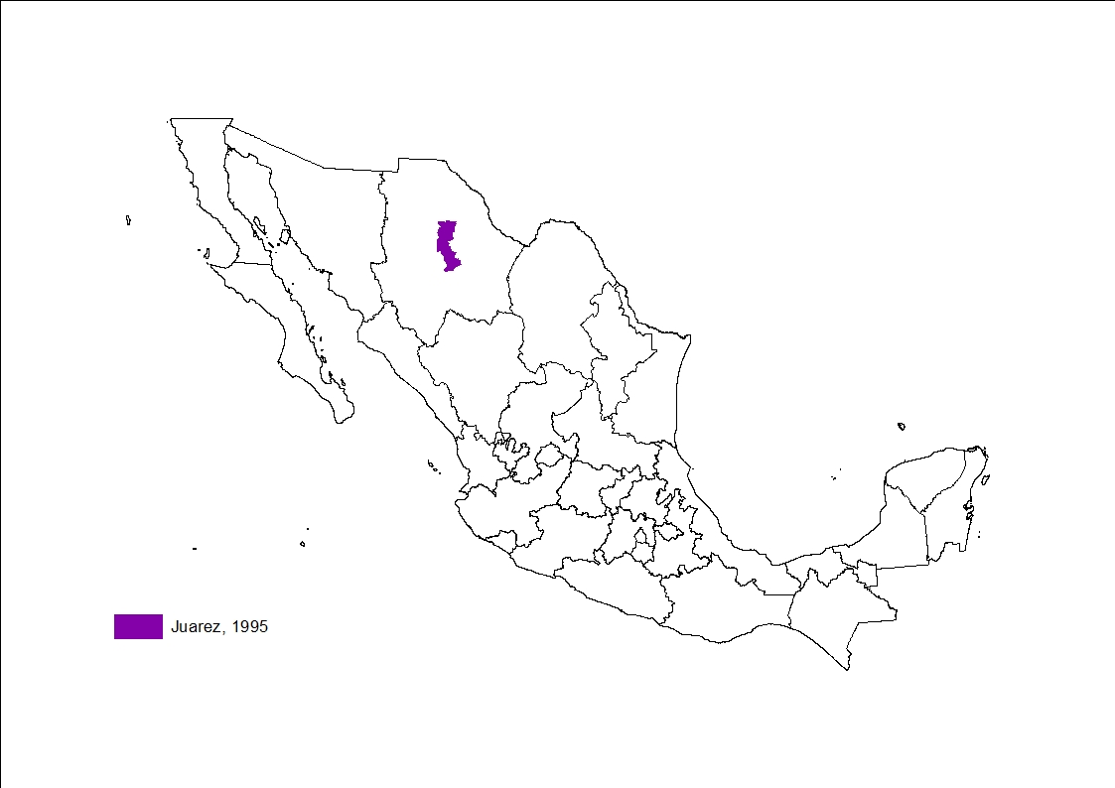
Back to main menu

Slide 65

Back to main menu

Slide 66

Back to main menu

Slide 67

Back to main menu

Slide 68

Back to main menu

Slide 69

Back to main menu

Slide 70

Back to main menu

Slide 71

Back to main menu

Slide 72

Back to main menu

Slide 73

Back to main menu

Slide 74

Back to main menu

Slide 75

Back to main menu

Slide 76

Back to main menu

Slide 77

Back to main menu

Slide 78

Back to main menu

Slide 79

Back to main menu

Slide 80

Back to main menu

Slide 81

Back to main menu

Slide 82

Back to main menu

Slide 83

Back to main menu

Slide 84

Back to main menu

Slide 85

Back to main menu

Slide 86

Back to main menu

Slide 87

Back to main menu

Slide 88

Back to main menu

Slide 89

Back to main menu

Slide 90

Back to main menu

Slide 91

Back to main menu

Slide 92

Back to main menu

Slide 93

Back to main menu

Slide 94

Back to main menu

Slide 95

Back to main menu

Slide 96

Back to main menu

Slide 97

Back to main menu

Slide 98

Back to main menu

Slide 99

Back to main menu

Slide 100

Back to main menu

Slide 101

Back to main menu

Slide 102

Back to main menu

Slide 103

Back to main menu

Slide 104

Back to main menu

Slide 105

Back to main menu

Slide 106

Back to main menu

Slide 107

Back to main menu

Slide 108

Back to main menu

Slide 109

Back to main menu

Slide 110

Back to main menu

Slide 111

Back to main menu
Back to main menu

Slide 112

Back to main menu

Slide 113

Back to main menu

